Slide 1
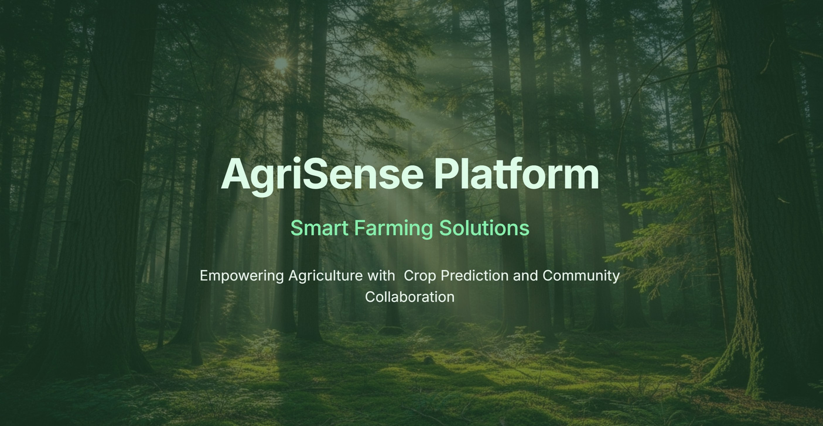

Slide 2
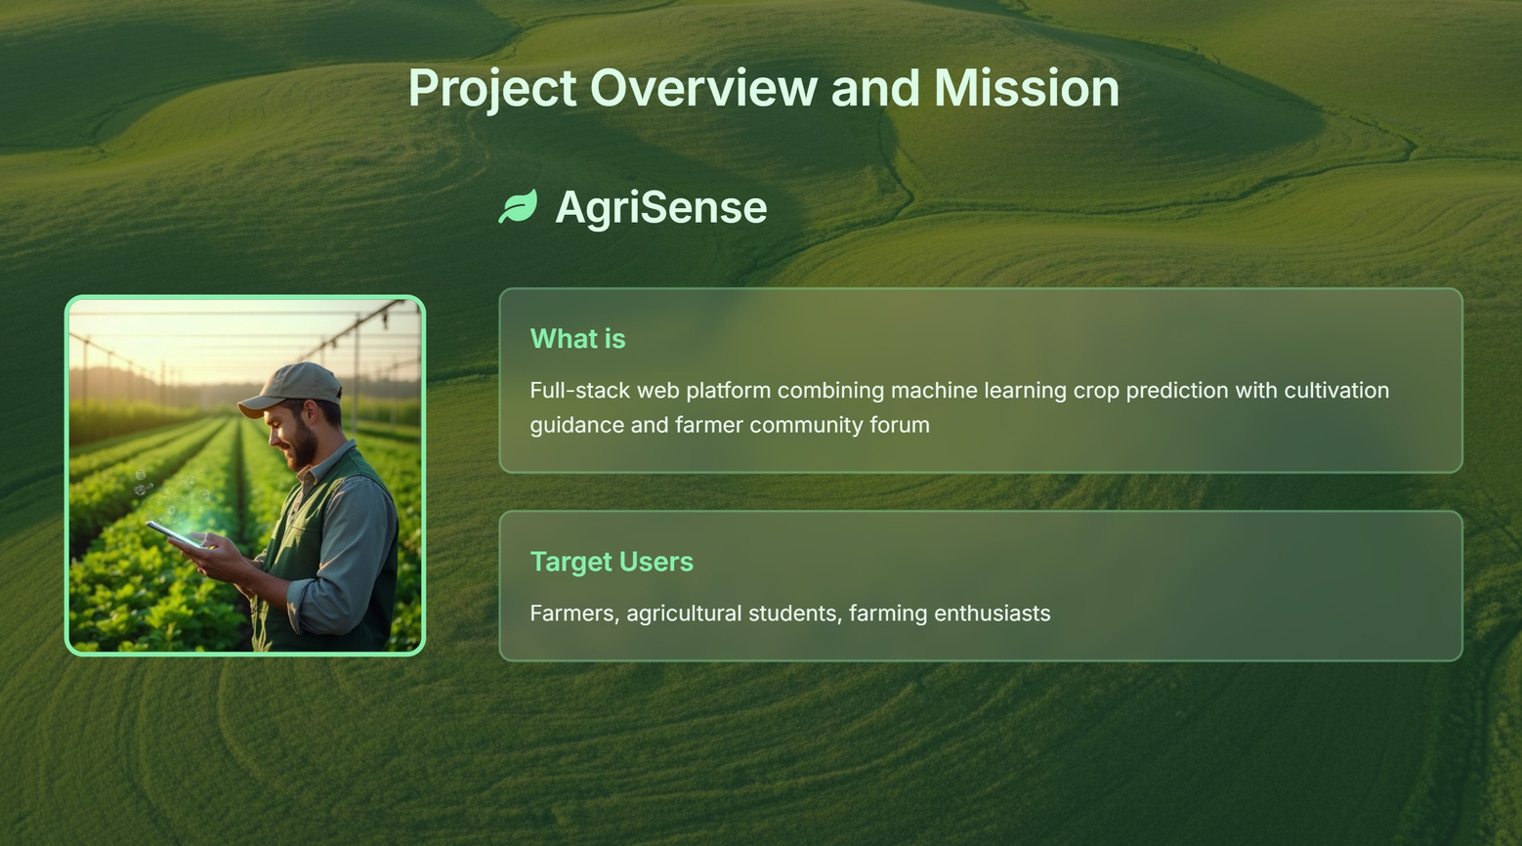

Slide 3
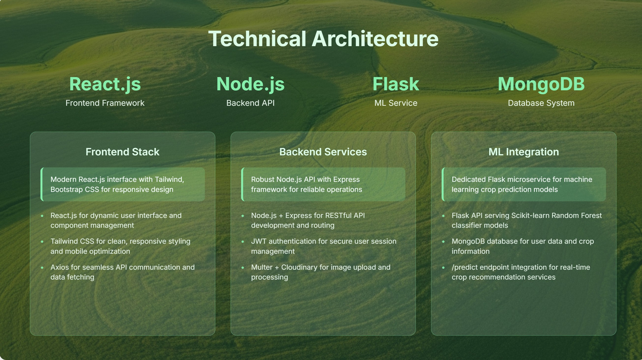

Slide 4
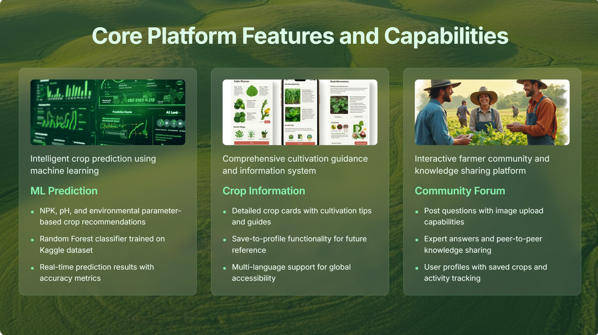

Slide 5
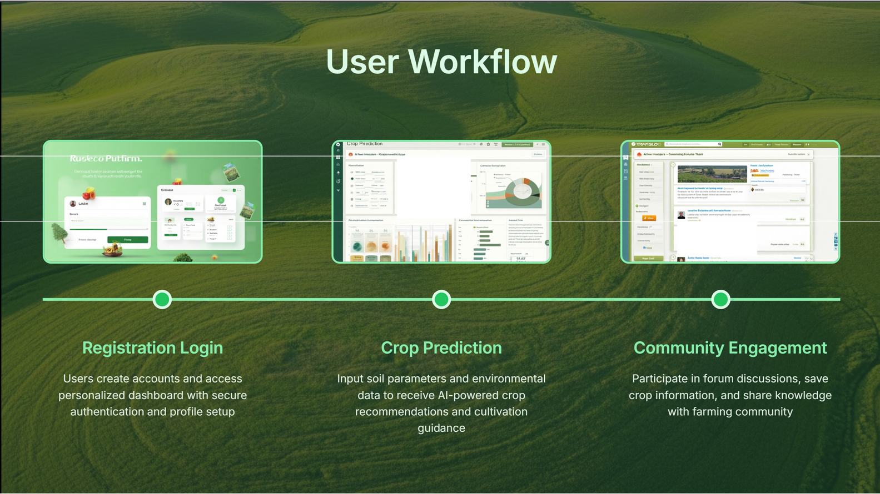
•1B'/30w=-
3Y.47.50lio
.. -
... _
.._.. ,
,,,
.,,_...._

Slide 6
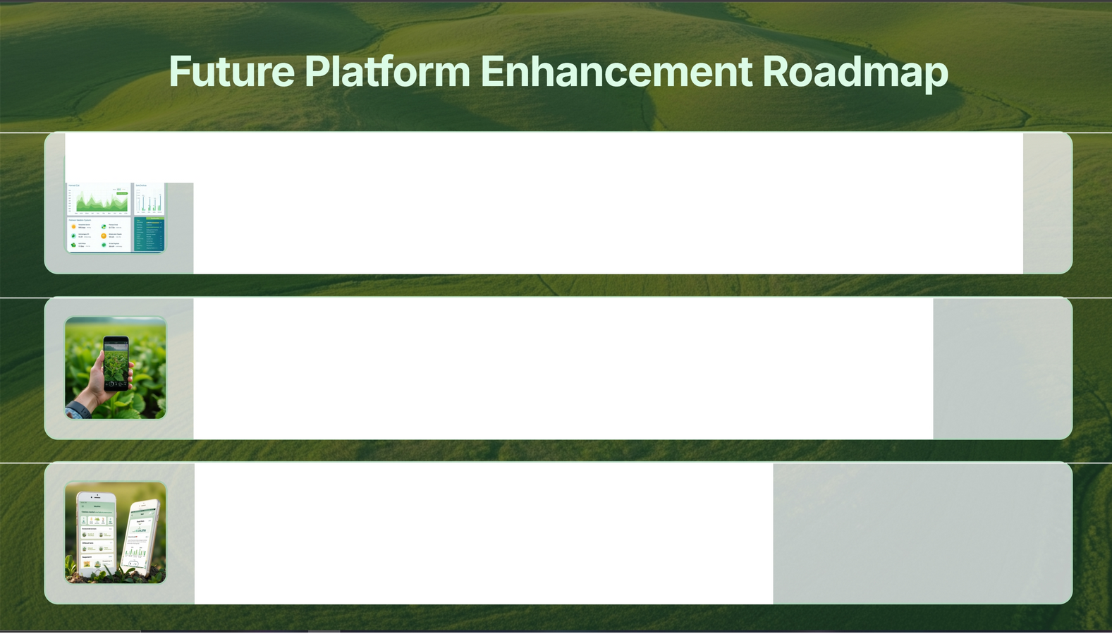
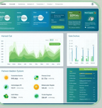
-.
- ;
.
;
. ...... | ;:. - | = ::c-- | - . -
. ...... | ;:. - | = ::c-- | - . - | Mo... -
Weather Integration API
Real-time weather data integration for enhanced prediction accuracy and climate-based crop recommendatio ns
Al Disease Detection
Computer vision-based pest and disease identification through image analysis for early intervention
Mobile Application
React Native mobile app development for field-based access and notifications

Slide 7


